Slide 2
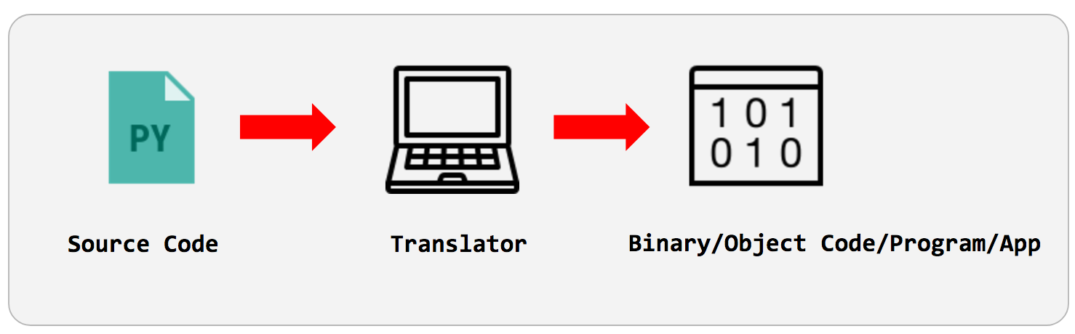
Introduction to Programming

Slide 3
Through this lecture, students will understand the steps for program compilation.
Students will learn the working of different translators that play role for compiling and executing program.
Learning
Outcomes

Slide 4
Contents
Introduction to Programming
Types of softwares
Translators

Slide 5
Outline of Topics
Hardware/Software Interface
Layers of Machine
Compile, Link, Execute and Errors
Kinds of software
Program
Syntax, Semantics, Grammars
Computer Languages

Slide 6

Software Categories
Application Software: Programs written for computer users.
Example :Word-processors, spreadsheets, & other application packages
System Software: Programs written for computer systems. Example: Compiler, operating systems

Slide 7
A Layered View of the Computer
Application Programs Word-Processors, Spreadsheets, Database Software, IDEs, etc…
System Software Compilers, Interpreters, Preprocessors, etc. Operating System, Device Drivers
Machine with all its hardware

Slide 8
Operating System (OS)
Operating System Services
Allocating memory and process time
Loading and running application programs
Creating and managing files which contain information
Providing Input and Output Facility

Slide 9
Programs
What is a program?
Characteristics
A special purpose and limited language
A set of rules and symbols used to construct a computer program
A language used to interact with the computer
Portable
Readable
Flexible
Efficient
Pieces of the same program can be written in different Programming language.
Languages closer to the machine can be more efficient
Notes:
https://www.79xperts.com/blog/good-computer-program/

Slide 10
Computer Languages
Machine Language
Uses binary code
Assembly Language
Uses mnemonics
High Level Language
Uses English-like language
Machine-dependent
Not portable
Machine-dependent
Not usually portable
Machine independent
Portable (but must be compiled for different platforms)
Examples: Pascal, C, C++, Java, Fortran

Slide 11
Computer Languages
High-Level Language
The representation of a computer program read and understood by the computer.
Instructions:
Assembly Language
A symbolic representation of the machine language of specific processor.
Machine Language
A programming language which use statements consisting of English-like keywords such as "FOR", "PRINT" or “IF“, ... etc.
A program consists of a sequence of machine instructions
Machine instructions are in binary code
Instructions specify operations and memory cells involved in the operation
Is converted to machine code by an assembler.
Each line of assembly code produces one machine instruction.
Mnemonic representation of the instructions and data
Much easier to program than assembly language.
Data are referenced using descriptive names
Operations can be described using familiar symbols
Programming in assembly language is slow and error-prone but is more efficient in terms of hardware performance.

Slide 12
Illustrations
Machine Language
Assembly Language Example: Load Price, Add Tax, Store Cost
High Level Language Example: Cost := Price + Tax
Operation | Address
0010 | 0000 0000 0100
0100 | 0000 0000 0101
0011 | 0000 0000 0110

Slide 13
Syntax & Semantics
Syntax:
The structure of strings in some language. A language's syntax is described by a grammar.
Example:
Binary number
<binary_number> = <bit> | <bit> <binary_number>
<bit> = 0 | 1
Identifier
<identifier> = <letter> {<letter> | <digit> }
<letter> = a | b | . . . | z
<digit = 0 | 1 | . . . | 9
Semantics:
Meaning of language

Slide 14
Syntax & Grammars
Syntax descriptions for a PL are themselves written in a formal language. Example:. Backus-Naur Form (BNF)
The formal language is not a PL but it can be implemented by a compiler to enforce grammar restrictions.
Some PLs look more like grammar descriptions than like instructions.

Slide 15
Compilers & Programs
Compiler
A program that converts another program from some source language (or high-level programming language / HLL) to machine language (object code).
Is distinguished from an assembler by the fact that each input statement, in general, correspond to more than one machine instruction.
Some compilers output assembly language which is then converted to machine language by a separate assembler.

Slide 16
Compilation into Assembly Language
Assembly Language
Source
Program
Compiler
Assembly Language
Machine Language
Assembler
Notes:
Instead of to ML
Facilitates debugging
Isolates compiler from changes in format of ML (new OS)
Only assembler must be changed!

Slide 17
Compilers & Programs
Computer program, written in some formal programming language, is written by the programmer.
Source Program
Compiled automatically into object code or machine code or executed by an interpreter
Pascal source programs have extension ‘.pas’
by an interpreter

Slide 18
Compilers & Programs
Object Program
Output from the compiler
Equivalent machine language translation of the source program
Files usually have extension ‘.obj’
Executable Program
Output from linker/loader
Machine language program linked with necessary libraries & other files
Files usually have extension ‘.exe’

Slide 19
What is a Linker?
A program that pulls other programs together so that they can run.
Most programs are very large and consist of several modules.
Even small programs use existing code provided by the programming environment called libraries.
The linker pulls everything together, makes sure that references to other parts of the program (code) are resolved.

Slide 20
Running Programs
Steps that the computer goes through to run a program:
Memory
Machine language program (executable file)
C P U
Input Data
Data entered during execution
Computed results
Program Output

Slide 21
Program Execution
Steps taken by the CPU to run a program (instructions are in machine language):
Fetch an instruction
Decode (interpret) the instruction
Retrieve data, if needed
Execute (perform) actual processing
Store the results, if needed

Slide 22
Program Errors
Syntax Errors:
Errors in grammar of the language
Runtime error:
When there are no syntax errors, but the program can’t complete execution
Divide by zero
Invalid input data
Logical errors:
The program completes execution, but delivers incorrect results
Incorrect usage of parentheses

Slide 23
Compilation
Source
Program
Compiler
Target
Program
Input
Target Program
Output
Compiler translates source into target (a machine language program)
Compiler goes away at execution time
Compiler is itself a machine language program, presumably created by compiling some other high-level program
Machine language, when written in a format understood by the OS is object code

Slide 24
Interpretation
Source
Program
Interpreter
Output
Input
The interpreter stays around during execution
It reads and executes statements one at a time

Slide 25
Compilation vs. Interpretation
Compilation
Interpretation
Syntax errors caught before running the program
Better performance
Decisions made once, at compile time
Better diagnostics (error messages)
More flexibility
Supports late binding (delaying decisions about program implementation until runtime)
Can better cope with PLs where type and size of variables depend on input
Supports creation/modification of program code on the fly (e.g. Lisp, Prolog)

Slide 26
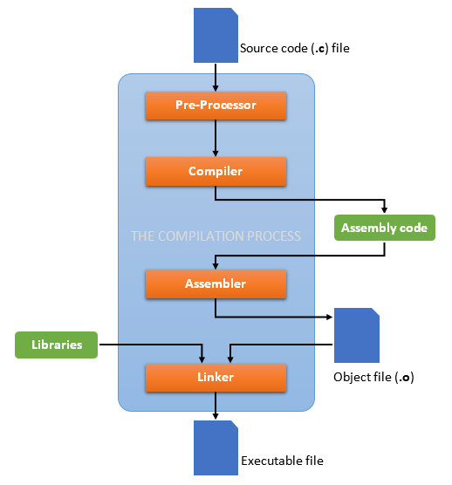
Compilation
Process

Slide 27
Thank You

